Slide 1

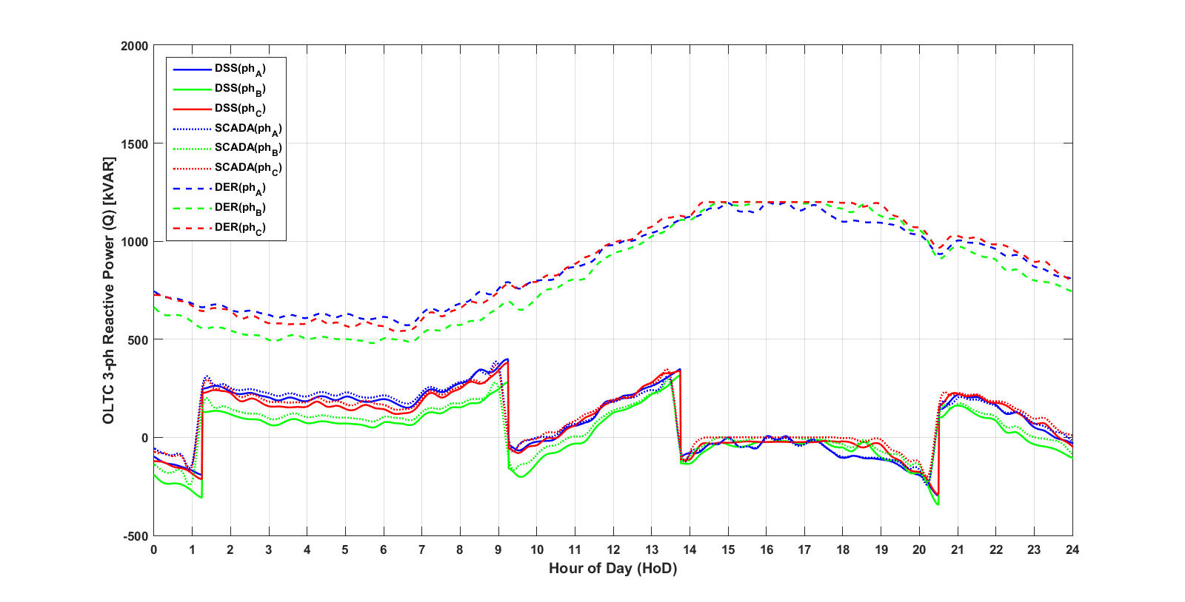
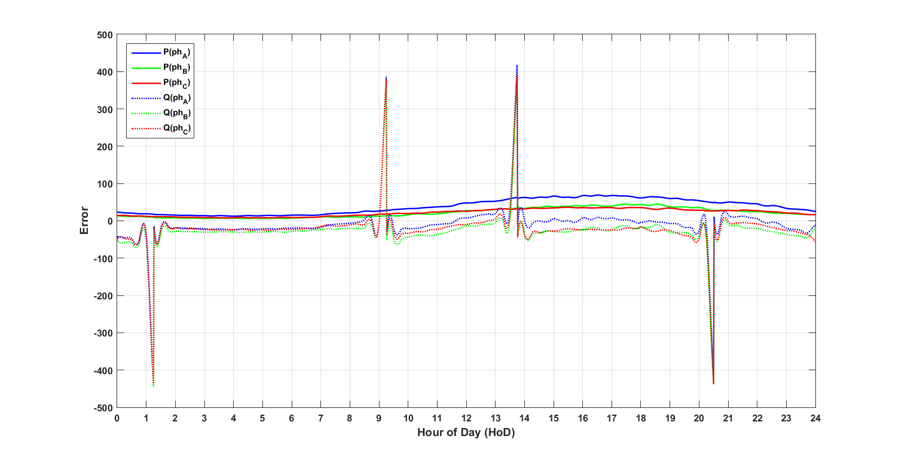
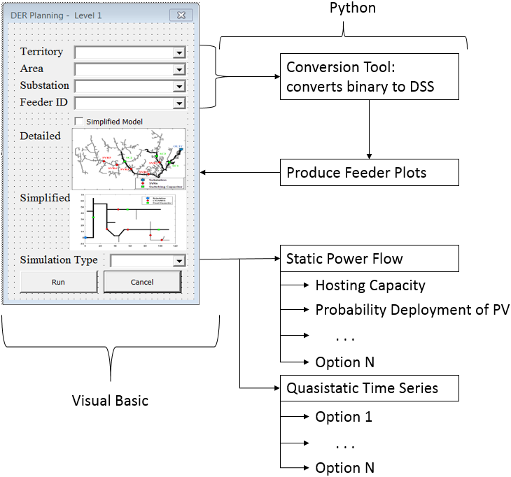
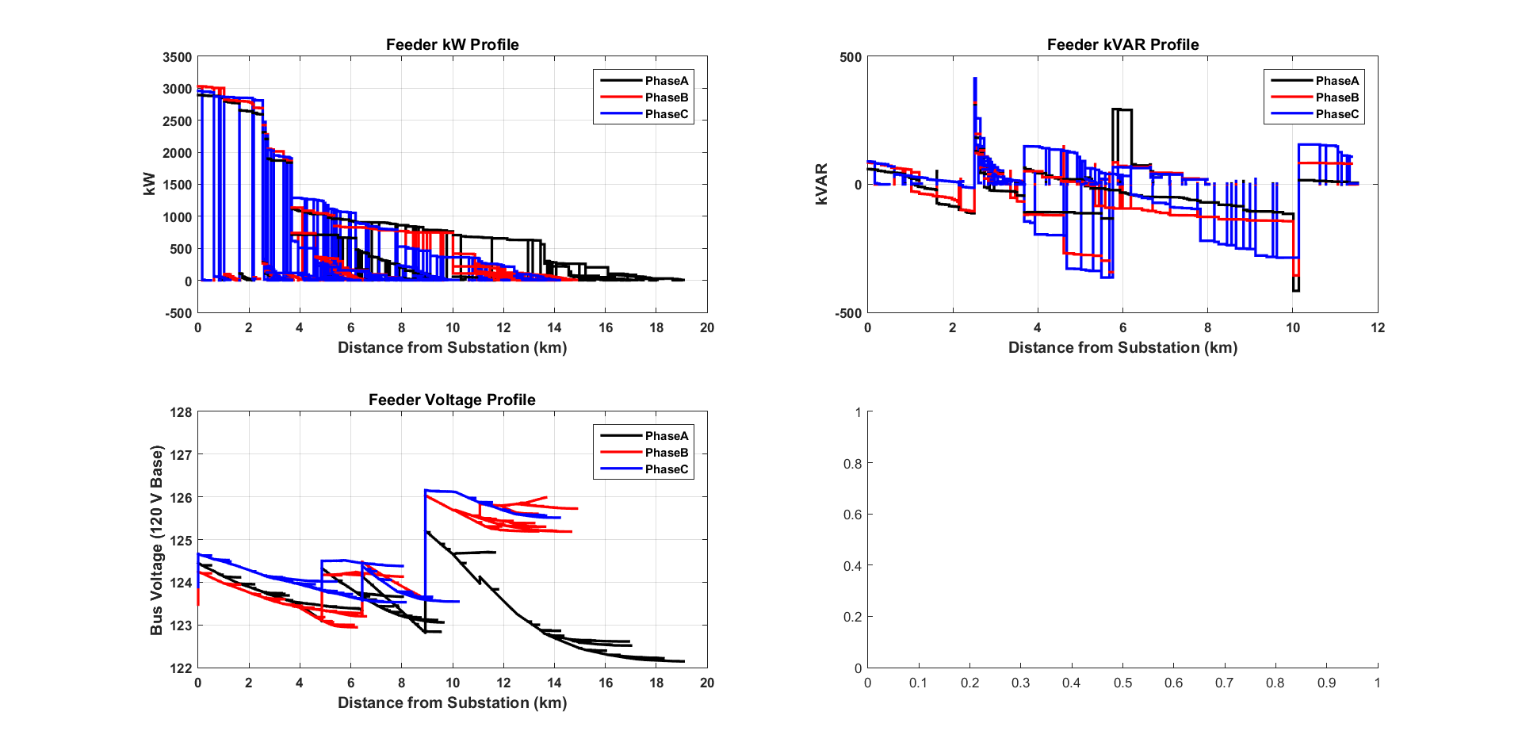
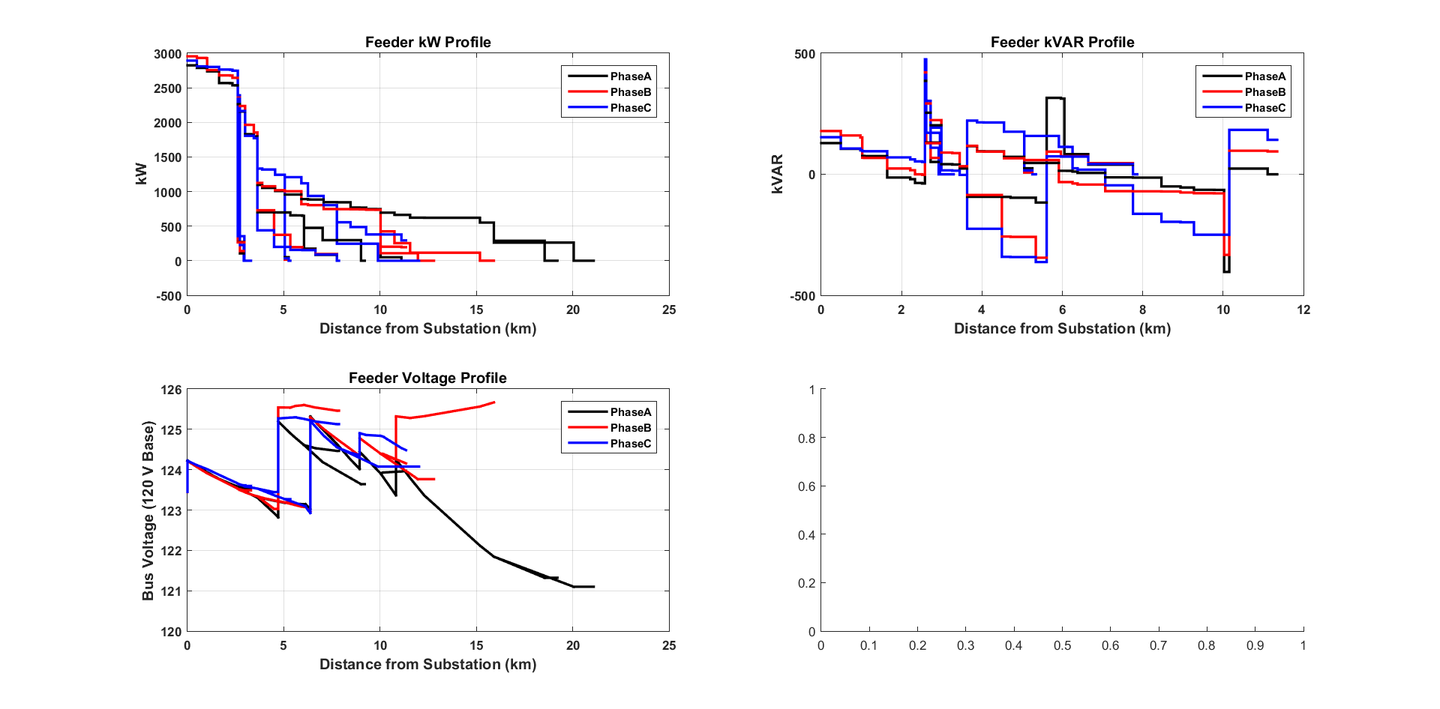
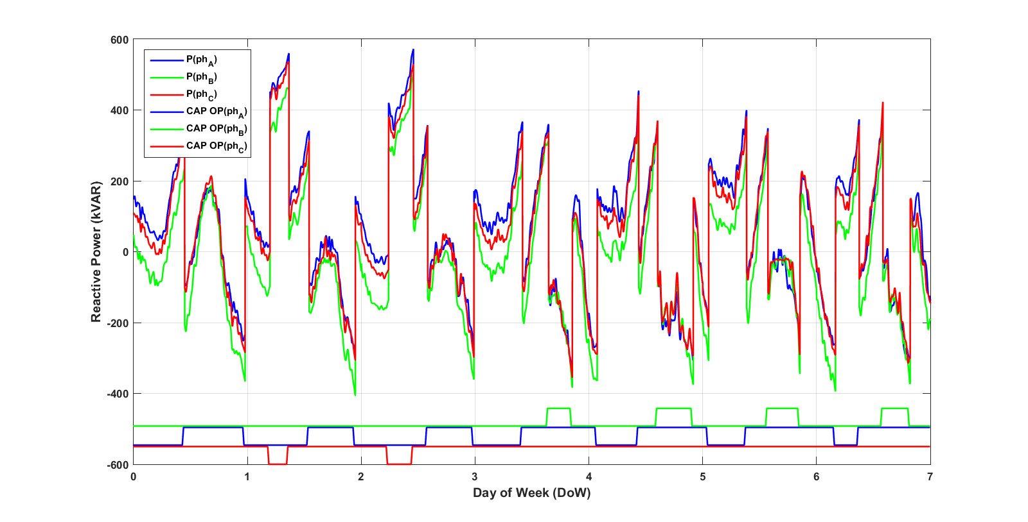

Comparison of Reduced Feeder Model to Detailed Feeder Model
Joshua Michael Burklew Smith, Undergraduate Research Assistant
Joseph Lavalliere, Graduate Research Advisor
The Holcombe Department of Electrical and Computer Engineering, Clemson University
INTRODUCTION
The increasing penetration of Distributed Energy Resources (DERs) on the grid requires a new approach to distribution and transmission planning. It took more than a century to plan and build the grid; we have only a fraction of that time to evolve solutions to the challenges of DER penetration. This time restraint, combined with limited planning personal, necessitates a planning tool to streamline our planning process.
MODEL SIMPLIFICATION
Resource Limitations
The greatest impediment to progress is a lack of resources. While software aids limited personal make better use of their limited time, we are limited by our computing resources – hardware. Efficient program design and frugal memory usage are the most economical solutions to the resource problem. The benefits of feeder reduction are summarized in Figure 1.
Figure 3a demonstrates the accuracy of the simulated (DSS) data, utilizing the reduced model, by comparing the historical data (SCADA). The derived (DER) data is incorporated to illuminate the capacitor operations. Figure 3b is included to show the kVAR error per phase; the large error surrounding capacitor operations is due to the difference between the time increment for telemetry and the time increment for the simulation.
CONCLUSION & FUTURE WORK
Feeder 04 was selected because of its size and complexity. The comparison of the results between the detailed model and reduced model suggests that feeder reduction is a viable solution to DER planning efficiency. The error introduced by the simplification is negligible when considering the time savings.
Developments in Python
Another resource constraint is funding. Unfortunately, MATLAB keys are relatively expensive. While MATLAB is a powerful tool easily utilized by academia, it is not an economical resource for utilities. In order to increase the accessibility of our DER planning tools, we will migrate away from a MATLAB environment. The plan is to start developing in Python - an open source language with Visual Basic compatibility.
While most programming languages are built off of the same underlying functions, each language boasts a different forte in regards to functionality and efficiency. Understanding Python’s functionality will hopefully provide greater efficiency than offered by the MATLAB counterpart of each tool.
Holistic DER Planning Tool
Integrating the planning tools into one user friendly program will improve user efficiency and allow easy addition of functionality. A basic concept is shown in Figure 5.
Model | Lines | Loads | Run Time
Detailed | 2196 | 1047 | ~ 2 day / year
Simplified | 67 | 78 | ~ 16 min / year
Reduction | 96.9% | 92.6% | 99.5%
Figure 3a – 24 Hour QSTS
Figure 3b – 24 Hour QSTS Error
VOLT / VAR Control
Freeing up memory will allow introduction of more parameters and longer periods of study - thereby offering more insight into system response. As technology improves, we are experiencing increases in the penetration of DER’s, EV’s, batteries, etc. Including these parameters in the detailed model would make the long runtime exponentially worse. Introducing these parameters to the simplified model will increase the runtime by only a fraction of the increase experienced by the detailed model. Figure 4 demonstrates the ability to utilize capacitor operations in the QSTS program; this suggests that we can utilize OpenDSS to analyze VOLT / VAR Controls.
Figure 1 – Reduction Summarization
Quasistatic Time Series (QSTS) Analysis
A tool was developed in MATLAB to perform Quasistatic Time Series analysis through a communication with OpenDSS. The tool accurately predicts feeder response as determined by a comparison of the detailed model to historical data. By simplifying the detailed model, we can reduce the runtime without losing performance. The static power flow of each model, shown in Figure 2, show that the reduced feeder accurately portrays the kW and kVAR characteristics of the detailed model as a function of distance from the substation.
Figure 5 – Holistic DER Planning Tool
Figure 1 – Static Power Flow for Detailed Model vs. Reduced Model
Figure 4 – 1 Week QSTS with Capacitor Operations

